Slide 1
Strategic Project Management
Estimation
Dr. Richard Scudder Copyright 2018
1

Slide 2

Agenda
Types of Estimations
  Strategic
  Sizing
  Parametric
  Task-based
Software tools
Cost and Time estimation
Case Study: Estimating Methods
Dr. Richard Scudder Copyright 2018
2
TB

Slide 3
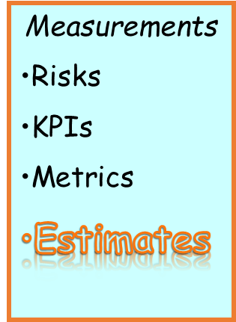
Effective Management
Processes
Portfolios
Programs
Projects
Defined Methods
Measure Results
Pilots
Baselines
Inputs
Management
Clients
Customers
Employees
Stakeholders
Consensus
Dr. Richard Scudder Copyright 2018
3

Slide 4
Project Estimating
Schedules, staffing plans, and budgets are dynamic, not
static -- they WILL change.
The rate at which you add people to the project affects both
productivity and cost.
Beyond the optimum staffing level, adding people will not
improve productivity - and may reduce productivity.
You can sometimes reduce costs by reducing the number
of people, and extending the schedule - but if the skill set is
missing you will increase costs.
Management can favorably influence productivity by
providing the right goals, tools, resources and time.
Dr. Richard Scudder Copyright 2018
4
Notes:
4
Project estimating is as good as the information provided: GIGO!!
More people working on a project does not = a more quickly completed project!

Slide 5
Types of Estimates
Strategic Estimate
  Executive team estimate based on strategic and portfolio needs.
Sizing Estimate
  Made by the project team at or near the beginning of a project to estimate overall time and cost. Compared to strategic estimate.
Task-Based Estimate
  Made during project to estimate next phase or phases.
Dr. Richard Scudder Copyright 2018
5
Notes:
5
If the sizing estimate and the strategic estimate are significantly different from one another, management needs to:
abandon the project as stated, or
investigate it more thoroughly.

Slide 6
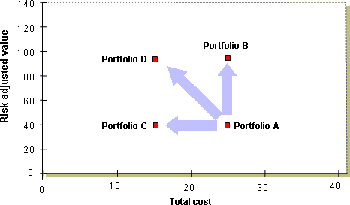
Which Portfolio is Best?
Dr. Richard Scudder Copyright 2018
6
Notes:
Definition of the Efficient Frontier
Suppose that an organization is currently conducting a set of projects represented by the point labeled Portfolio A in the graphic shown above. Economists would describe Portfolio A as inefficient because there is another project portfolio, Portfolio B that produces more value for the same cost. Similarly, there is also a Portfolio C that produces the same value for less cost. Furthermore, there is a Portfolio D with a combination of these two characteristics.

Slide 7
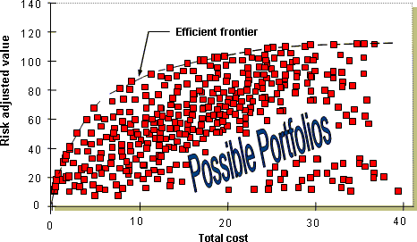
The Best Portfolio Set
Dr. Richard Scudder Copyright 2018
7
Notes:
Now suppose we consider all of the alternative project portfolios that can be constructed from a set of project proposals. Typically there are many and the diagram above shows a real example. In this case the organization had 30 project proposals under consideration in one budget cycle. Four of those projects were considered mandatory (3 process fixes and a new initiative required by regulators) leaving 26 discretionary projects. In general, if there are N potential projects, there are 2 exp N possible project portfolios because there are a total of 2 exp N subsets within a set of N items. (For more explanation see the paper Mathematics: Methods for Solving the Capital Allocation Problem, available on my website). Thus, this application required evaluating 2 to the 26th power or approximately 67 million portfolios, far more than shown above! The best portfolios define the efficient frontier.
The best project portfolios define the efficient frontier
Notice that the efficient frontier is curved, not straight. This is because the efficient frontier is made up of the best possible projects in the least-cost portfolios, i.e. those portfolios that show up first on the left side of the curve. Such portfolios create the greatest "bang-for-the-buck". As the cost constraint is relaxed and more projects can be added, the new projects are not quite as good as those included earlier. The slope of the curve encompassing these projects is flatter because their bang-for-the-buck is not quite as high. Thus, there is a declining return in the value obtained with each additional increment of cost. This is what causes the curve to transition as shown above.

Slide 8
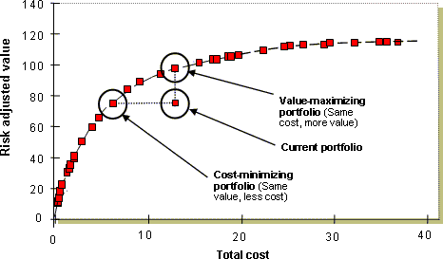
Value Vs Cost
Dr. Richard Scudder Copyright 2018
8
Notes:
It is relatively easy for a computer, with an efficient optimization engine, to try various combinations and locate the efficient frontier, provided the right algorithms are in place. These algorithms must be set for determining how the costs and benefits of individual projects combine to determine the costs and benefits of the project portfolio as a whole. In simple situations where projects are independent and risks are either independent or do not matter, the costs and value of the project portfolio are basically just sums of the costs and values of the individual projects. However, if there are interdependencies or a need to adjust for risks, more sophisticated models are required.
Evidence that finding the efficient frontier adds considerable value
If we locate the efficient frontier, then for any specified total portfolio cost we can pick the specific project portfolio that produces the greatest possible value. The diagram above, derived from an actual application, shows that an alternative portfolio was found that increased value by over 30% without increasing costs. Similarly, an alternative portfolio was found that reduced costs by 40% without decreasing value. This result is typical. Application of the efficient frontier approach shows that current project portfolios are often well below their potential.
Project portfolio enhanced by applying the efficient frontier
The Efficient Frontier Moves Over Time
It should be noted that the efficient frontier is not static. Organizations face the challenge of finding project alternatives that advance the frontier. As project managers better understand the link between their project designs and the value derived by the organization, they create better project proposals. Also, better technology creates new opportunities that create more value for less cost. This causes the efficient frontier to move up over time. The fundamental goal, though, remains the same -- Create as much value as possible using as little capital as possible. To do this, you must find the efficient frontier.

Slide 9
Software Tools for Estimation
A variety of tools exist
  Most are for construction and IT environments
  Use multiple models for estimating
Some broader tools like TruePlanning can be used on a wide variety of projects.
Dr. Richard Scudder Copyright 2018
9

Slide 10

Strategic Estimates
Done at Portfolio Management level
Overall perspective on:
  Resource use
  Materials
  Equipment
  Capital expenditure/Budget
  Contracting
  Risk
  Financial return
Projects compared for greatest value
Dr. Richard Scudder Copyright 2018
10
Notes:
10
Management’s best opportunity to create a successful project!
Define the project
Define the parameters (ROI, budget, etc.)
Involve the correct people
Make the estimate

Slide 11
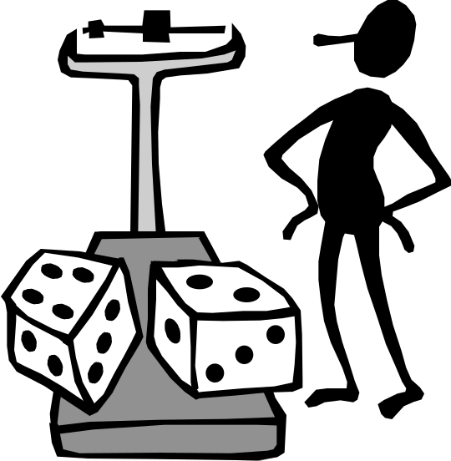
Strategic Estimate
Based on best knowledge at time of portfolio assessment
Picked because of strategic value of project to the organization

Slide 12
Strategic Estimate:
High Level Approximation
Project go/no decision
Business case focus
Make Vs. Buy analysis
Prioritization in Portfolio
Focus on overall cost, effort or general overall timeframe
Rough order of magnitude with an uncertain confidence level
Dr. Richard Scudder Copyright 2018
12

Slide 13

Sizing Estimates
Use broadly at the beginning of the project or phase
May be parametric, analogous, range-based
Partially software driven in some industries
  Sales: Quoting software (Quick-Quote)
  Construction: Take-off and Estimating (BidPoint)
  Manufacturing: Product Configurators (DBA)
  Software: LOC or FP estimators (SPC)
Dr. Richard Scudder Copyright 2018
13
Notes:
13
What is it that we think we are doing??
Does that agree with what management and the customer wants/needs?
An early place to determine if we, the project team, understand what the project is intended to be.

Slide 14

Task Based Estimates
Software may be part of solution.
Based on understanding the WBS, the staff and the work.
Much more detailed.
Can be used to manage a project.
Dr. Richard Scudder Copyright 2018
14
Notes:
14
The nitty-gritty If these aren’t reasonably correct, God help you!

Slide 15
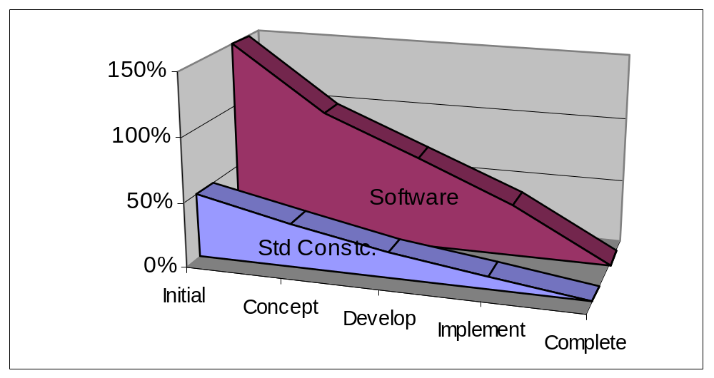
Precision Range
Relative estimation precision
Dr. Richard Scudder Copyright 2018
15
Notes:
15
Contractors usually have about a 6% leeway that the architect and owner will give them.
Software projects routinely run 100% over!

Slide 16

Assumptions should be communicated
Are there project goals which have not been put in the business case?
Are there terms, definitions, concepts which need clarification?
Are there expensive standards to comply with?
How will this project differ from previous projects? What new tasks have been added?
Are there technology and design decisions that have already been made?
Are there other projects in other parts of the organization which could cause this estimate to be wrong?
Are there areas of disagreement?

Slide 17

Historical Information
Use historical information; does
your organization have project
information from the past?
Is the data valid?
Is the data relevant?
Same project type
Equivalent technical environment
Staff
Politics
Commitment
Dr. Richard Scudder Copyright 2018
17
Notes:
17
The past is no predictor of the future.
But guessing is far, far worse as a predictor.
Keep data from your projects; learn from it.
Feed the learnings back into the organization’s processes to improve your estimates.
Compare apples to apples!

Slide 18
Expert Based
Relies heavily on the experience of the estimators
Best when historical project metrics are available
Should be used in conjunction with other estimating techniques
Works for S shaped projects
not so well for exponential
Dr. Richard Scudder Copyright 2018
18
Notes:
Top down vs bottom up estimating.
S curve= Slow start, quick momentum, slow finish
Exponential – Similar to baking a cake slow start, fix resources, then accelerating momentum until project is finished. If resources are removed to soon (half baked) then project fails. If cake is baked to long, then resources are wasted
With and s shaped project there is more flexibility with the budget. With exponential projects, you had better plan from the bottom up. The ultimate act of disempowerment is to take away the scheduling from the people that have to do it.
18

Slide 19
Consensus Based
Project team, clients and interested parties participate
Assumptions must be normalized
Multiple inputs compared and integrated
Delphi approach can be used to gather data
Dr. Richard Scudder Copyright 2018
19

Slide 20
Using Historical
Information for LOP
Sizing Estimate
Gather the information from whatever sources are available
Try to get three numbers (L.O.P.) -
  Likely Time
  Optimistic Time
  Pessimistic Time
Use the numbers with the L.O.P. technique
Dr. Richard Scudder Copyright 2018
20
Notes:
20
A big enough body of completed projects which are comparable to the current project will allow a pretty good sizing estimate.
If you have no data, your sizing estimate will have to come from a preliminary WBS, followed by estimates of the tasks and activities identified.
Likely, Optimistic, Pessimistic estimates work amazingly well, as long as the number of pieces estimated is at least 5-7. The maximum number of pieces for a true sizing estimate is somewhere around 20-25. After that, the value of adding additional pieces drops off very rapidly.

Slide 21
L.O.P
Likely, Optimistic and Pessimistic
Using an estimating worksheet, record your most likely
effort time, your most pessimistic, and your most
optimistic effort.
Optimistic: Assuming that everything falls into place,
and that there are no unforeseen problems, what is the
shortest possible time to complete this project (or task)?
Likely: What will this project take given normal
circumstances?
Pessimistic: If everything goes wrong, how long
will the project (or task) take?
Document your assumptions as necessary.
Dr. Richard Scudder Copyright 2018
21
Notes:
21

Slide 22
Estimating Statistics
Use simplified statistics to help understand the
most probable estimate for the task and the
range of time between the optimistic and likely.
The Bell Shaped Curve
Skewed
Distribution
Optimistic
Likely
Pessimistic
Estimated Time =
OP + 4 (Likely) + PE
6
The project is likely to be completed within the range from optimistic to
pessimistic 95% of the time (2 standard deviations). There is also a 2.5%
chance that it will be finished in less than the optimistic estimate.
Dr. Richard Scudder Copyright 2018
22
Notes:
22

Slide 23
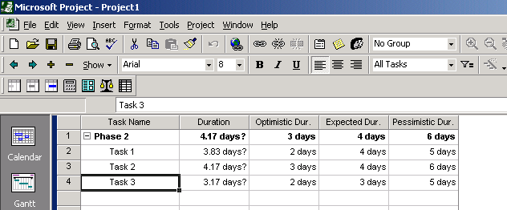
LOP
Dr. Richard Scudder Copyright 2018
23
Notes:
23

Slide 24
Work Distribution Model
Based on definition of the project lifecycle
Uses project history (History Repeats Itself)
Used with the other modeling techniques as a reality check
Uses LOP for each piece (could be as small as a task or as large as a phase)
  For best results, the minimum number of pieces is 5 to 7 … maximum is 30
Dr. Richard Scudder Copyright 2018
24

Slide 25

Wideband Delphi Tool
Name | Script
Purpose | A repeatable process for estimation. Using it, a project team can generate a consensus on estimates for the completion of the project.
Work Products | Input Vision and scope document, or other documentation product being estimated Output Work breakdown structure (WBS) Effort estimates for each of the tasks in the WBS

Slide 26
Wide Band Delphi
Name | Script
Entry Criteria | The following criteria should be met in order for the Delphi process to be effective: • The vision and scope document (or other documentation that defines the scope of the work product being estimated) have been agreed to by the stakeholders, users, managers, and engineering team. If no vision and scope document is available, there must be enough supporting documentation for the team to understand the work product. • The kickoff meeting and estimation session have been scheduled (each at least two hours). • The project manager and the moderator agree on the goal of the estimation session by identifying the scope of the work to be estimated.

Slide 27
Wide Band Delphi
Name | Script
Basic Course of Events | Choosing the team. The project manager selects the estimation team and a moderator. The team should consist of three to seven project team members. The team should include representatives from every engineering group that will be involved in the development of the work product being estimated. 2. Kickoff meeting. The moderator prepares the team and leads a discussion to brainstorm assumptions, generate a WBS, and decide on the units of estimation. 3. Individual preparation. After the kickoff meeting, each team member individually generates the initial estimates for each task in the WBS, documenting any changes to the WBS and missing assumptions.

Slide 28
Wide Band Delphi
Name | Script
Basic Course of Events (Con’t.) | 4. Estimation session. The moderator leads the team through a series of iterative steps to gain consensus on the estimates. At the start of the iteration, the moderator charts the estimates on the whiteboard so the estimators can see the range of estimates. The team resolves issues and revises estimates without revealing specific numbers. The cycle repeats until either no estimator wants to change his or her estimate, the estimators agree that the range is acceptable, or two hours have elapsed. 5. Assembling tasks. The project manager works with the team to collect the estimates from the team members at the end of the meeting and compiles the final task list, estimates, and assumptions. 6. Reviewing results. The project manager reviews the final task list with the estimation team.

Slide 29
Wide Band Delphi
Name | Script
Other paths | 1. During Step 1, if the team determines that there is not enough information known about the project to perform an estimate, the script ends. Before the script can be started again, the project manager must document the missing information by creating or modifying the vision and scope document. 2. During either Step 1 or 3, if the team determines that there are outstanding issues that must be resolved before the estimate can be made, they agree upon a plan to resolve the issues and the script ends.
Exit Criteria | The script ends after the team has either generated a set of estimates or has agreed upon a plan to resolve the outstanding issues.

Slide 30

Basis of Estimate Process
Written justification for estimate:
  What estimating techniques were used
  Who participated in the estimating process
  Identification of projects used for comparison
  Historical data used in estimate
  Confidence level of the estimate

Slide 31
Sizing Models
Do NOT use sizing estimates to lock in project schedules.
Sizing estimates are “order of magnitude only.”
Use as a first “guess.” Then re-estimate as information becomes available.
Dr. Richard Scudder Copyright 2018
31
Notes:
31
Using estimating to leverage Project Maturity:
Level 2 KPAs
One of the goals of the Software Project Planning KPA is, "Software estimates are documented for use in planning and tracking software projects." The software plan is expected to include size estimates for all work products, along with cost and schedule estimates. A software-estimating model with the capability to estimate software size, cost, and schedule provides an excellent tool for institutionalizing these estimating practices.
The main value a software-estimating tool can add at this point in your process improvement venture is the ability to estimate software cost and schedule consistently and logically. The software-estimating model acts as the lowest common denominator, aiding the process of putting software projects into a common framework so that information can be learned from each project and applied to many others.
Imagine that you are a software project manager who has just delivered a software project late and over budget. You are gearing up for the next project and would like to learn from this past experience. How do you evaluate where you went wrong? Using your software-estimating tool as a guide, you can determine values for the input parameters that would have led you to the right answer based on the actual experiential data you have collected. Once you have done this, you can, based on what you know about this new project, determine which of these input parameters will need to change and how the input values might change. Using a commercial model for estimating facilitates the creation of a common language for discussing project cost drivers and aids in the development and implementation of a documented process.
One of the goals of software project tracking and oversight is taking and managing corrective actions when the results deviate from the plan. A software-estimating model can be a useful tool in reaching this goal as well. When a well thought-out estimate turns out to be incorrect, this is generally because assumptions made about the project were incorrect. Incorrect assumptions lead to incorrect inputs. The software project team can review the original inputs to the model and compare them to actual information to date. This review helps highlight where incorrect assumptions have been made and offers the opportunity to re-plan the remaining portion of the project based on more accurate versions of assumptions.
Suppose you are involved in an effort to estimate a software project that represents a new market for your organization. In developing your original estimate you made and documented (through an input wizard in the tool) assumptions about your software development team's capability to learn and apply domain knowledge for this new market. You also assumed that the team was proficient in the technologies employed. The critical design review shows the project late and over budget. You are tasked with determining what went wrong, and what the real cost and schedule should be.
You look back at the original estimate and compare it to what you know about the project. First of all, the team took much longer than expected to obtain domain knowledge. Additionally, once the project got underway, they determined that the incorporation of a new development technology was required to achieve all of the project goals. After modifying the inputs to your estimating tool and regenerating the estimate, leaving all other parameters the same, the critical design review cost and schedule is much closer to the actual. You now have an estimate to complete with a new level of credibility. Care should be taken to make sure that use of an estimating tool does not lead you to overlook factors outside the scope of the tool. You may find that there was nothing wrong with your original estimate, but that the missed deadline was due to unforeseeable organizational changes for which no tool could account.
Another process area where a software-estimating tool can be included is the Software Subcontract Management KPA. Not only does there need to be a process for planning software developed on site, but also for reviewing and checking the plans provided by a subcontractor. These plans, too, are based on size, cost, and schedule estimates. Subcontracting organizations can also use the language that a commercial tool offers for talking about things that drive cost.
Level 3 KPAs
As an organization begins to attack the required processes to move from repeatable to defined processes, the focus shifts from the project level to the organizational level. One goal of the Organization Process Focus KPA is coordination of process activities at the organizational level. A key part in achieving this goal is the organization's software process database, which collects process and project data. A commercial estimating model requires inputs to develop a generic framework that describes product and project characteristics (such as functionality, quality, size, complexity, and reuse) in such a way that permits comparisons across the organization. Various organizational groups can use this language to compare dissimilar projects in ways that provide useful analysis to feed the improvement process.
For example, imagine you work for an organization that develops avionics for both military and commercial applications. The military side of the house is attempting to evaluate the cost impact of incorporating a new technology that the commercial side has been using for some time. Using the data learned from the commercial avionics development, the software estimator only needs to change information directly related to the operating platform in applying lessons learned to evaluate how this new technology would change costs on a military application. The input parameters for the model help focus the evaluation on what is different and what is the same when performing this type of comparison, and help remove noise from the comparison.
As processes begin to be defined at an organizational level, the real power of a commercial model becomes clear. Part of the Integrated Software Management KPA requires that an organization use data in the software project database for software planning and estimating. This is a process that cost estimating professionals call calibration, and it is automated as part of the many good estimating tools. As noted earlier, in implementing a commercial tool, the organization has already committed to storing data in the process database in a way that makes comparisons possible at an organizational level. The tool then has the capability to look at this historical data, which describes the actual past performance of the organization, and use it to improve the estimates made from that point.
Another question frequently asked is how inputs to the estimating model might need to change as the company progresses to higher levels of maturity. The beauty of a process improvement approach such as that dictated by the CMM is that once an organization has reached a new level of maturity, they already know the answer to this question. The increased data collection and analysis with more mature organizations provides the information required for calibrating and tailoring the inputs to reflect organizational maturity accurately. The value of the tool itself is improved tremendously by the processes that utilize it.
Level 4

Slide 32

TASK BASED ESTIMATES
Dr. Richard Scudder Copyright 2018
32
Notes:
32

Slide 33

Task Based Estimates
Task Based Estimates can only be done once you have finished your Work Breakdown Structure
Estimates rely upon:
  Baseline Data
  Human Resource Profiles
A Network Diagram is critical
Dr. Richard Scudder Copyright 2018
33
Notes:
33

Slide 34
Effort Baseline
One of the keys to estimating is gathering a
history.
This becomes the source for deciding the
effort and cost required to complete typical
tasks.
Many of the tasks on a project are
repeatable processes.
From these repeatable processes we can
create a normalized metric or "flat rate."
Dr. Richard Scudder Copyright 2018
34
Notes:
34
History again!
Auto mechanics can make reliable estimates of effort because they have a flat rate book, which tells them how long a given repair or maintenance job (task) should take.
Project managers need a similar “flat rate” book to tell them how long a task or activity should take.
Project history is the closest we can come to that flat rate book.

Slide 35

Effort Baseline
High skill level - no technical learning curve
Good application knowledge - no project
learning curve
Full time assignment to the task
No interruptions
Dr. Richard Scudder Copyright 2018
35
Notes:
35
The theoretical top employee.

Slide 36
EVF
Effort Variance Factor
Technical Skill Factor
(SF)
Work Interruption Factor
(WIF)
Loss for Part Time Assignments (PT)
Dr. Richard Scudder Copyright 2018
36
Notes:
36
Now modify that perfect performer’s estimate

Slide 37
Technical Skill Factor
Skill factor (SF) considers how familiar the person is with the business side of the project and how competent he or she is technically:
  SF of 1 = Extensive experience
  SF of 2 = Average
  SF of 3 = Novice
Dr. Richard Scudder Copyright 2018
37
Notes:
37
How skilled are they?
Expert = ?? 3 times as fast as beginner, and 2 times as fast as the average person??
Must have history to know what is true for your organization.

Slide 38

Work Interruption Factor
That portion of the average day not directly related to project work:
  Coffee breaks
  Meetings
  Training
  Telephone
  Etc, etc…
The average is 60% availability
40% of your time is interrupted
Dr. Richard Scudder Copyright 2018
38
Notes:
38
Your people never take breaks!
They work from dawn to dusk without ever drinking coffee, gossiping, or going to the bathroom.

Slide 39
Part Time Effect
Reflects BOTH mathematical and situational factors:
A two day effort should take four days if you
are working half-time...however:
Have you considered ramp-up, ramp-down time?
Put in an efficiency factor to help you consider
the effects of ramping.
Dr. Richard Scudder Copyright 2018
39
Notes:
39
A computer can switch from one task to another with no down time, but …
Humans need to come up to speed on a new project or a new task.
Thus there is a lag in performance.

Slide 40
Part Time Assignments
The more interruptions, the greater the time devoted
to ramp up and ramp down. Include at least a 10%
factor if a resource is part time.
- especially in knowledge work!!
Dr. Richard Scudder Copyright 2018
40
Notes:
40
The more mentally intensive the work is, the more time most people will need to come up to speed on any given task.

Slide 41
Calculating EVF
EVF=SF*(100/(100-WIF))*(100/(100-PT))
Example:
SF = 1.5
(a better than average worker)
WIF= 25%
(Interrupted less than normal)
PT = 10%
(Working on other projects as well)
EVF = 1.5*(100/100-25)*(100/100-10) = 2.2
EVF = 1.5*(1.3)*(1.1) = 2.2
..then multiply the EVF times the baseline.
Dr. Richard Scudder Copyright 2018
41
Notes:
41
This excellent employee who has relatively few interruptions and not too many other responsibilities …
Takes 2+ times as long, calendar wise, to finish the task as you would expect!

Slide 42
Team Size
Productive
Hours
900
600
400
Team
0
20
40
60
80
100
Size
A 20 person team can be as productive as a 94 person team.
Tom DeMarco says 5 should be the maximum team size.
Dr. Richard Scudder Copyright 2018
Learning Rate
42
Notes:
42
Fewer people generally equals a stronger team. The quality of the decisions and performance generally go down as the number of people on the team increases.

Slide 43
Estimating the Project
Task-Based
Use a comprehensive WBS
Create Baseline Information
Compute EVF for each resource
Develop a potential PERT
Normalize the PERT using resource profiles
Iterate the PERT to get the overall estimate
Dr. Richard Scudder Copyright 2018
43
Notes:
43
The real nuts and bolts of estimating. Your most accurate estimate.
Re-estimate from time to time to determine if your previous assumptions were actually correct.

Slide 44
Caveat
No estimate is guaranteed to be accurate:
  People get sick or leave the organization
  Teams run into unforeseen technical problems
  The needs of the organization change
  The economy changes
  The unexpected happens
Dr. Richard Scudder Copyright 2018
44

Slide 45
Set Realistic Estimates
Estimates are subjective to some degree
Setting easy targets leads to doing no better than meeting those targets
Setting too optimistic targets leads to counterproductive short cuts to meet those targets
Overly optimistic targets also lead to the denial of inconvenient risks
Dr. Richard Scudder Copyright 2018
45

Slide 46


Rolling Wave Estimates
Strategic Estimate
Sizing Estimate
Sizing Based
High Level
Task -Based
Detailed
Complete
Phase 1
Phase 2
Phase 3
Dr. Richard Scudder Copyright 2018
46
Notes:
46
Estimate the whole project, then re-estimate the whole project using a different set of people.
Complete part of the project, then make a detailed estimate of the next phase, and a high-level estimate of the rest of the project.
Continue to do this as you complete parts of the project.
Keep checking your assumptions!! Things change as you complete parts of the project, and that will usually affect the remaining estimates.

Slide 47

Multiple Methods
In order to do accurate estimating of projects, more than one
method will be necessary. It is also wise to seek help from
outside the project team if estimating expertise is not included.
Some of the elements of good estimation include:
P
EOPLE
Experts
Team Members
.
METHODS
Sizing Methods
Task Based Estimates
Dr. Richard Scudder Copyright 2018
47
Notes:
47
Use multiple methods to sanity check your project estimates.

